Slide 1
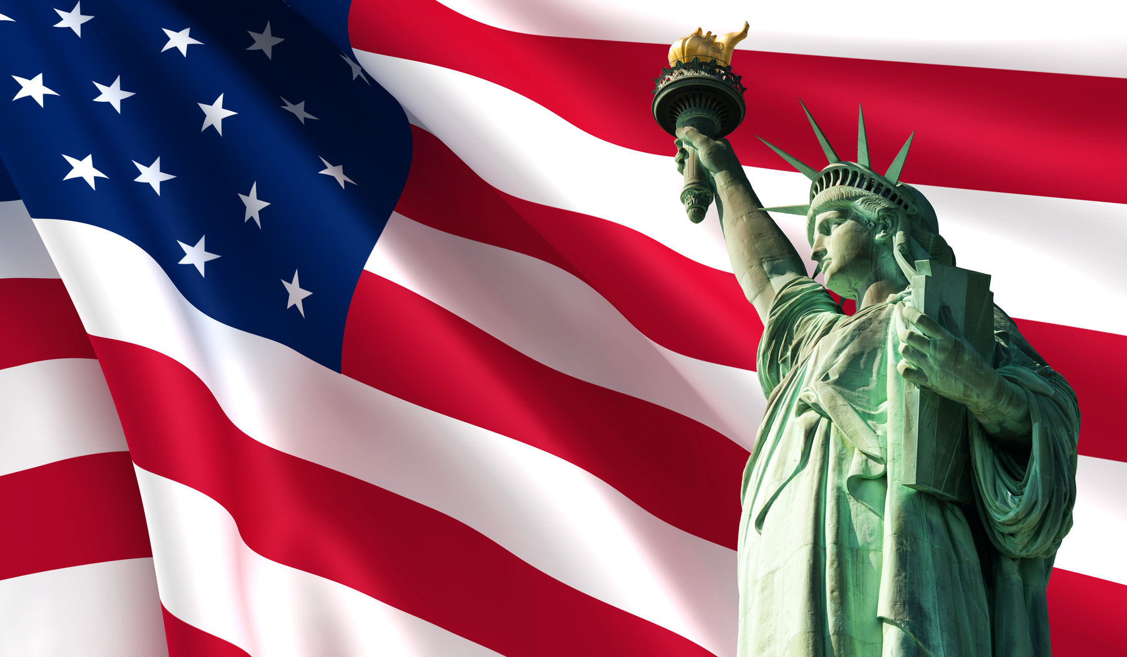
Mass Immigration and Immigrant Labour
Year 11 Modern History

Slide 2

SOCIAL IMPACTS – Class Divisions
From 1890s onwards, most migrants to the United States came from Italy, Russia and Austro-Hungarian Empire
America is a Melting Pot
USA mixed society
By 1920 103 nationalities
Motto: “From the Many: One” – immigrants should lose old identity and become Americans
Reality is attitudes toward each new group treated with suspicion
Immigrants given worst jobs, poorest pay

Slide 3
WASPS (White Anglo-Saxon Protestants), white settlers, British, Germans, Scandinavians. Best jobs, most money, more political power
Immigrants from Southern and Eastern Europeans (Russia, Poland, Italy) escaping persecution (Jews, Catholics). Railway workers, immigrant labour
Hispanics (Central and South America), Asian immigrants. Working on cattle ranches, railroads, cities
Negroes (African Americans). Slavery ended 1865. Farm labourers, factory workers, Jim Crow Laws.
Native Americans. 1850-1890s forced off their land by westward expansion. By 1917 majority lived on reservations.
Social divisions = The hierarchical organisation by which a society or community is divided into classes.
America divided:

Slide 4
ECONOMIC IMPACTS – immigrant labour
Mass influx of migrants created huge labour force which in turn, provided workers in the railway and industrial (factory) industries
This in turn, contributed to the economic boom during the Gilded Age, Second Industrial Revolution and during the Progressive Era to WW1 (allowing America to produce and sell munitions to countries involved and making huge profits).
The economy’s total output increased by 85 per cent between 1900 and 1910.
Economic inequalities with those at top of social hierarchy
Migrants worked long hours for low pay
Dangerous conditions in factories and mines

Slide 5
POLITICAL IMPACTS – Federal Immigration Regulation
For much of the 1800s, the federal government had left immigration policy to individual states. However, by the final decade of the century, the government decided it needed to step in to handle the ever-increasing influx of newcomers.
1882 Chinese Exclusion Act passed limiting number of Chinese immigrants
Workers in California worried about losing jobs to Chinese who would work for less money
1890 Ellis Island, New York (where Statue of Liberty located) became federal immigration station.
More than 12 million immigrants entered US through Ellis Island
No guarantee of being allowed into US
Immigrants had to be registered when arriving at Ellis Island
Health checks/screening
Registration forms

